Slide 1

SCREENING FOR CHRONIC KIDNEY DISEASE (CKD)
Group 6 - Neel Kumtakar, Yusi Luo, Daniel Le, Kim-Cuong Nguyen, Micheal Said, Jing Wang

Slide 2
TABLE OF CONTENTS
INTRODUCTION
INITIAL ANALYSIS
MODEL FITTING

Slide 3

INTRODUCTION & OBJECTIVE
CKD can easily be found by drawing simple lab tests, but at-risk populations are not routinely tested for CKD.
Objective: to develop an effective model and easy-to-use screening tool to identify patients with high risk of CKD so that early treatment can be applied.
Dataset: 6,000 observations – 33 variables
Methodology: logistic regression -> identify significant variables -> build predictive model & create screening tool
“The best protection is early detection”

Slide 4
INITIAL ANALYSIS
Figure: CKD dataset – Continuous variables
Notes:
Talk about the findings related to age & SBP as in the report

Slide 5
INITIAL ANALYSIS
Figure: CKD dataset – Binary variables
Notes:
Talk about the findings as in the report. Race first, then Educ vs Income, then Hypertension, then a list of diseases like PVD,….. (as stated in the report)

Slide 6




Data exploring
Missing Value
Imputation
Split the dataset
DATA PREPROCESSING
1,864 observations (31%) have missing value
13.2% Income value missed
Using multiple imputations (MICE)
Linear regression for continuous variables
Logistic regression for categorical variables
6,000 observation
33 variables
75% Train dataset
25% Validation dataset

Slide 7
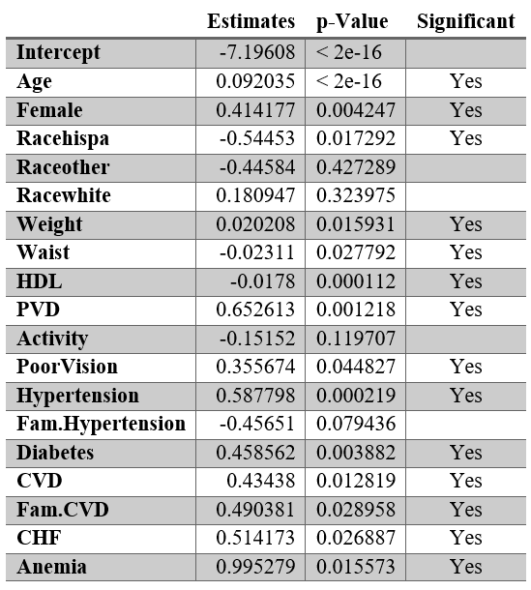
MODEL DEVELOPMENT
Purpose: Develop predictive model -> identify variables for screening tool.
Key features of the screening tool:
Simplicity: this should be a tool that our grandparents could well understand and use.
Accuracy: this is a must.
Figure: Backward Elimination Model Summary

Slide 8
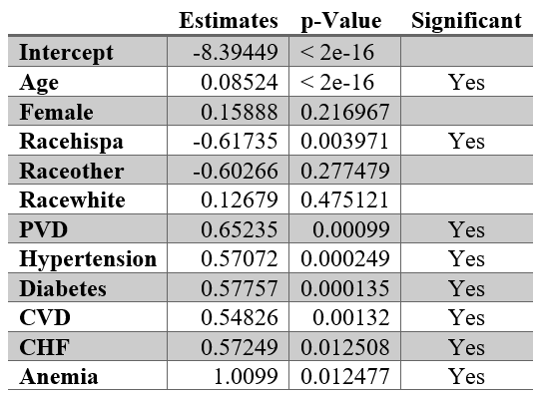
MODEL DEVELOPMENT
Figure: Backward Elimination Model Summary
Figure: Reduced Model Summary

Slide 9
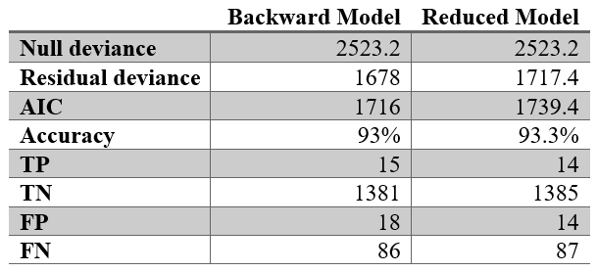
MODEL DEVELOPMENT
Figure: Comparison Between Two Models
Accuracy was conducted at cutoff level of 0.5.
Backward Model is more significant.
Similar accuracy.
=> We decided to go with the reduced model.

Slide 10
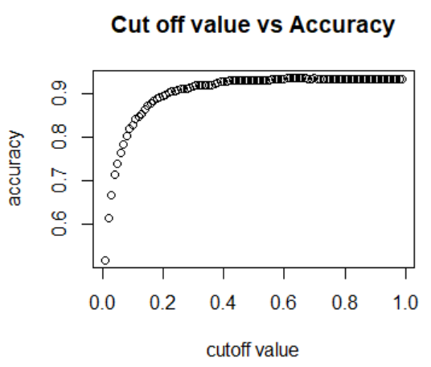
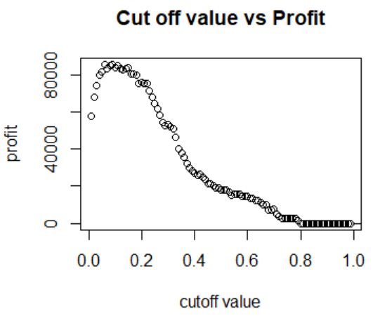
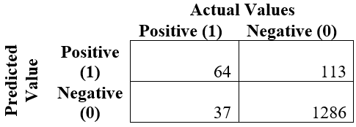
MODEL DEVELOPMENT
Figure: Cutoff value vs Accuracy & Profit
Cutoff value: 0.22
Accuracy: 90%
Profit: $71,900
Figure: Confusion Matrix

Slide 11





General Information
Health Information
SCREENING TOOL
What is your age? | Below 50 (0) | 50-59 (3) | 60-69 (4) | Above 70 (5)
 | ◻ | ◻ | ◻ | ◻
What is your gender? | Male (0) | Others (0) | Female (1)
 | ◻ | ◻ | ◻
What is your race? | Black (0) | Hispanic (0) | Others (0) | White (1)
 | ◻ | ◻ | ◻ | ◻
Do you have Peripheral Vascular Disease (PVD)? | No (0) | Yes (1)
 | ◻ | ◻
Do you have hypertension? | No (0) | Yes (1)
 | ◻ | ◻
Do you have diabetes? | No (0) | Yes (1)
 | ◻ | ◻
Do you have Cardiovascular disease (CVD)? | No (0) | Yes (1)
 | ◻ | ◻
Have you ever had Congestive Heart Failure (CHF)? | No (0) | Yes (1)
 | ◻ | ◻
Are you having anemic? | No (0) | Yes (1)
 | ◻ | ◻
Total Points: ? /13
Instructions: If total point is 8 or higher, the patient need to undergo more testing.

Slide 12

LIMITATION
Bias from data imputation
Incomplete dataset: no info on family history of kidney disease
Backward selection model drawback: may include variables that are not necessary.
Incorrect input by patients

Slide 13
The best protection is early detection!
THANK YOU!

